Slide 1
Your [United] Way
Team 3

Slide 2
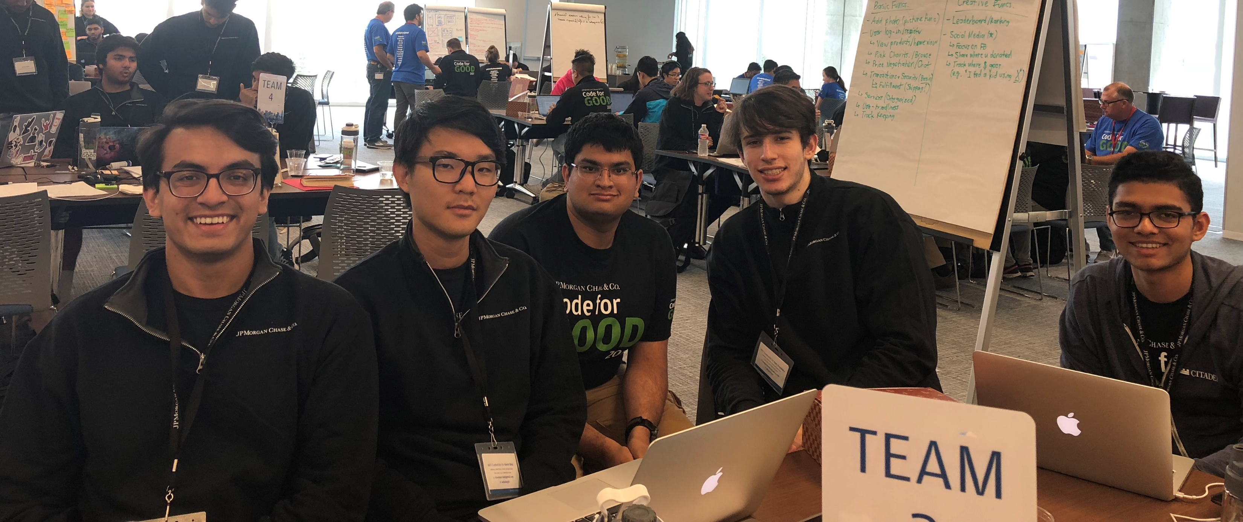
The Team

Slide 3

Goals for Sprints
Brainstorming
Design
Task Breakdowns
Code!
Testing

Slide 4

Factors & Implementation
Basic Functionality
Market Place
Buy
Sell
Charities
Account
Creative Features
Entertaining UX Design
Smart Recommendations
Image Recognition

Slide 5

Front-End Implementation
Android Studio
Visual Studio
Expo
React Native

Slide 6

Back-End Implementation
Flask
Imagga
eBay Web Scraping

Slide 7
Work Flow
Application
Camera
Item Info.
Button: Sell
Button: Charities
Charity Info.
Button: Account
Acct. Info.
Buy
Buy Info.

Slide 8

Final Product

Slide 9
Retrospection

